Slide 1
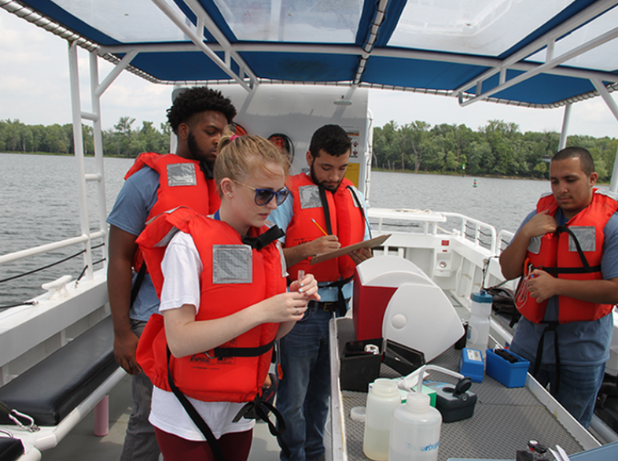
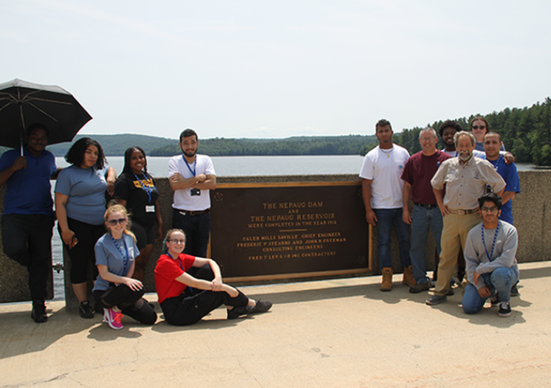
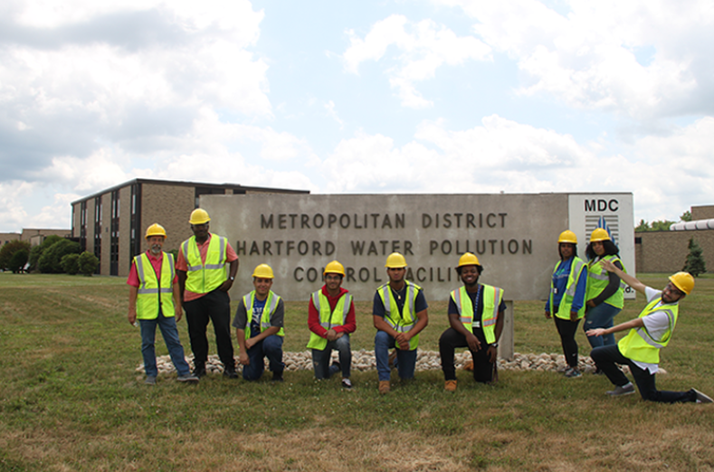
Learn and Earn Final Ceremony

Slide 3
Barkhamsted
Alma Robledo

Slide 4
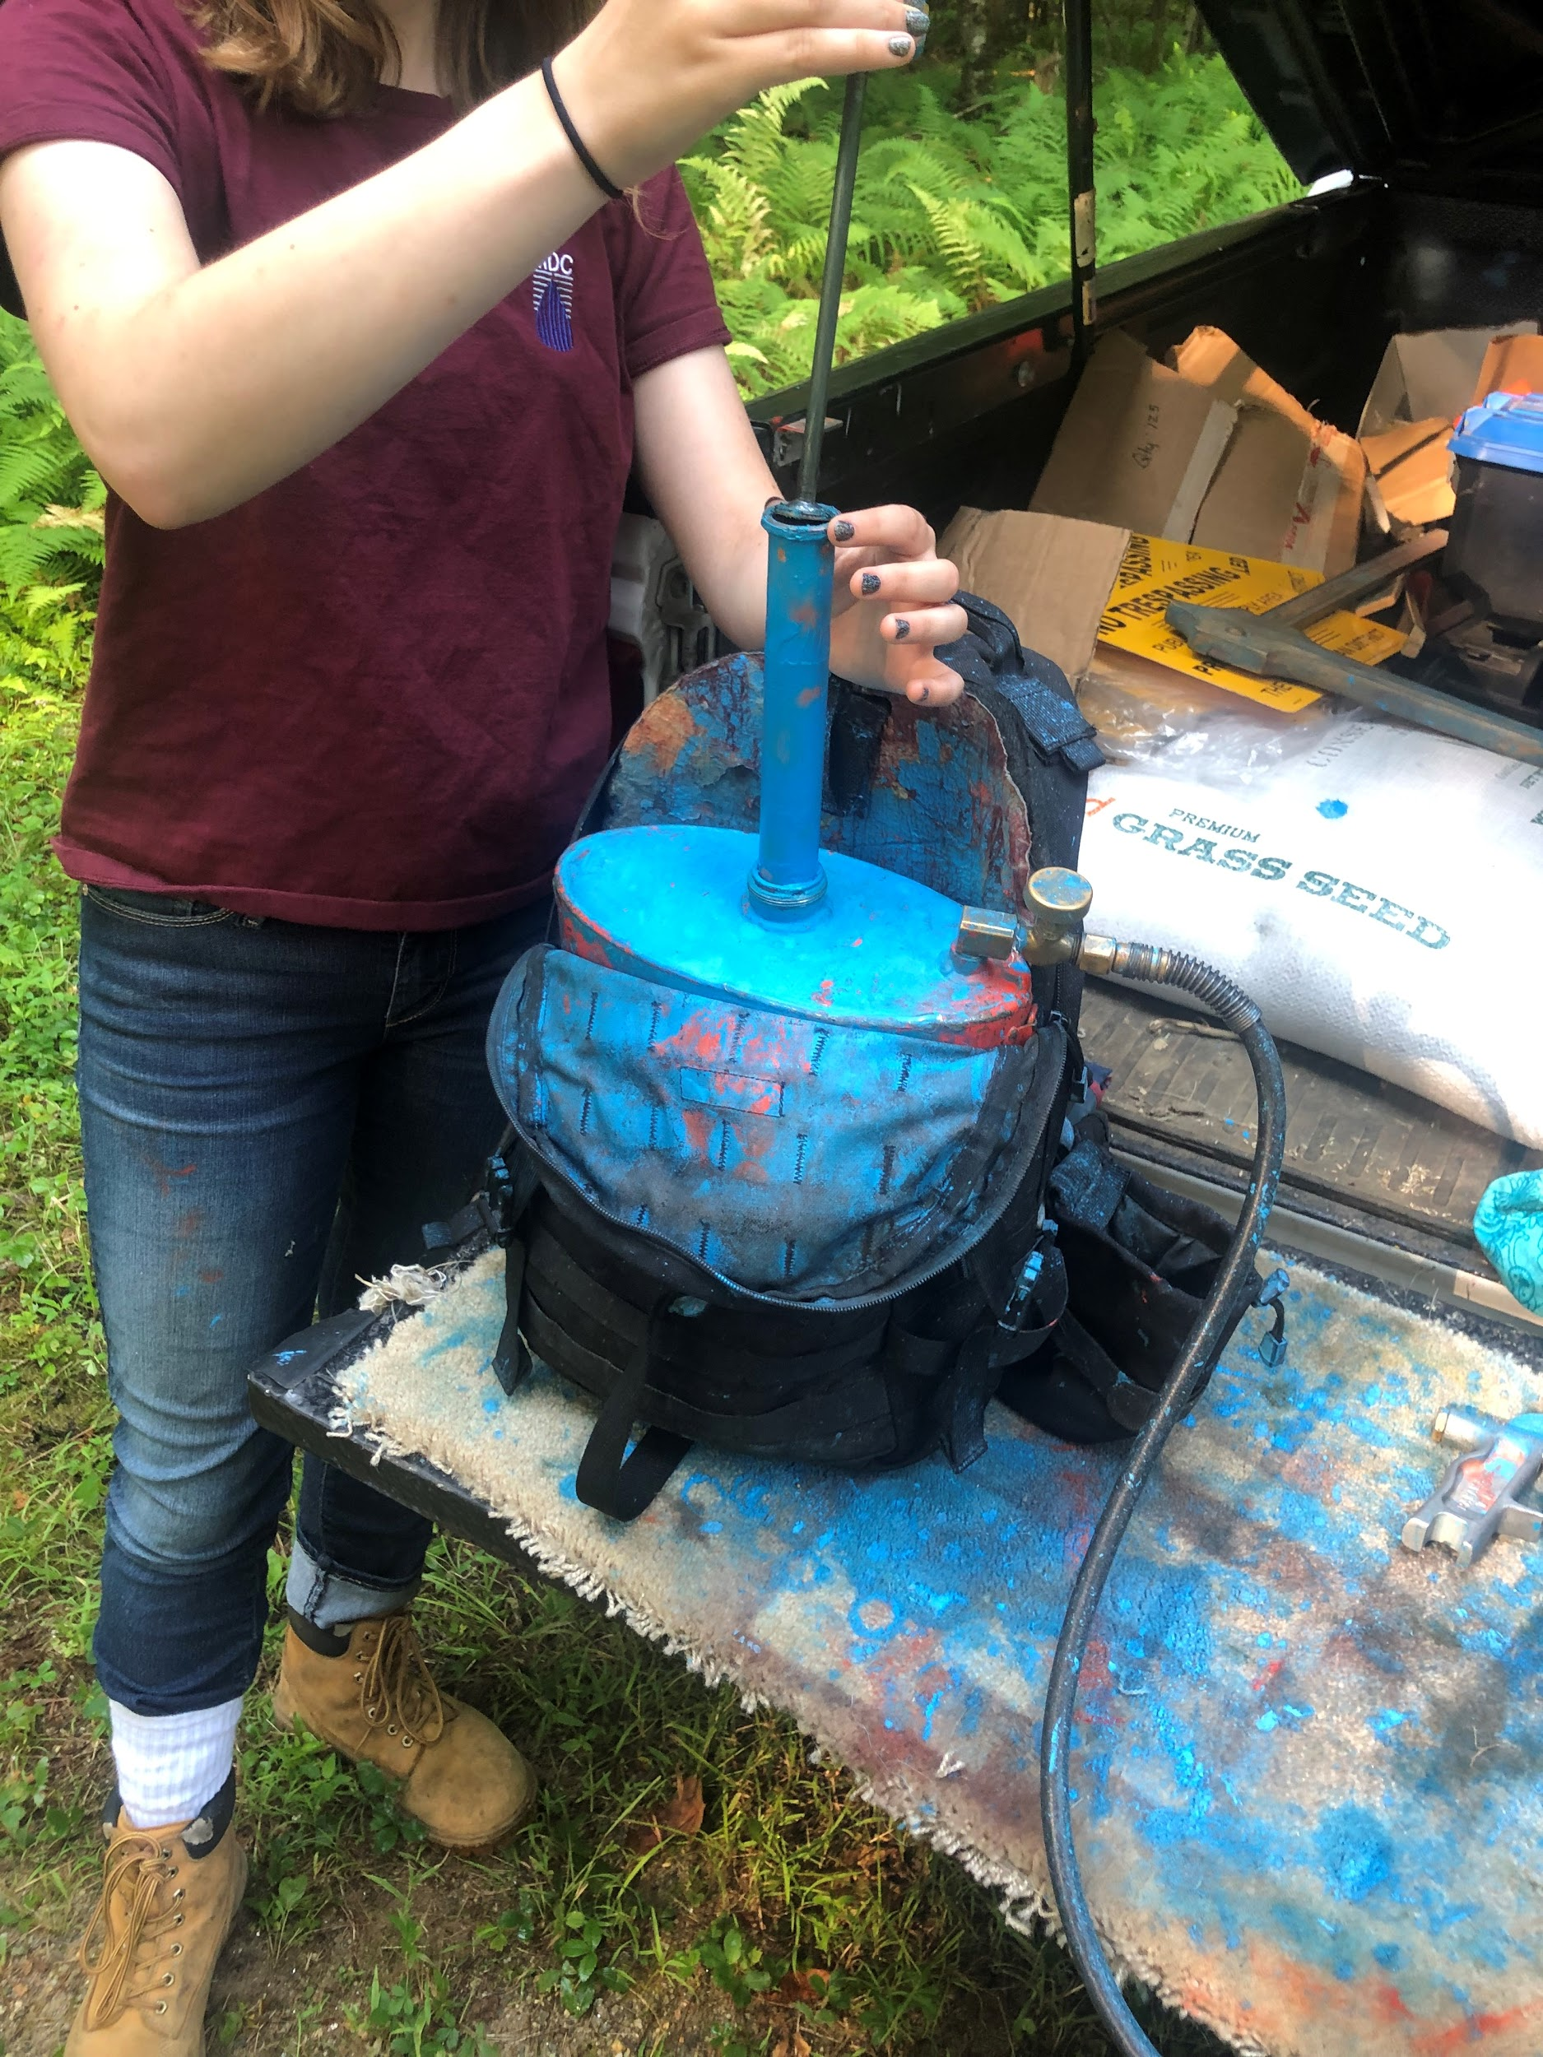
Work Responsibilities / What I Learned
Responsibilities
Marking down trees for lumber
Checking water at gate houses
Surface and submerged sampling
Inspecting deer fences
Shadowing employees
Learning how to clear trails
Learned
Not all about water
Forest has a big impact on the quality of the MDC’s water
Methods to marking the trees (diameter, amount of supply, types of trees)
Importance of clearing the trails (for recreational use and employees access)

Slide 5
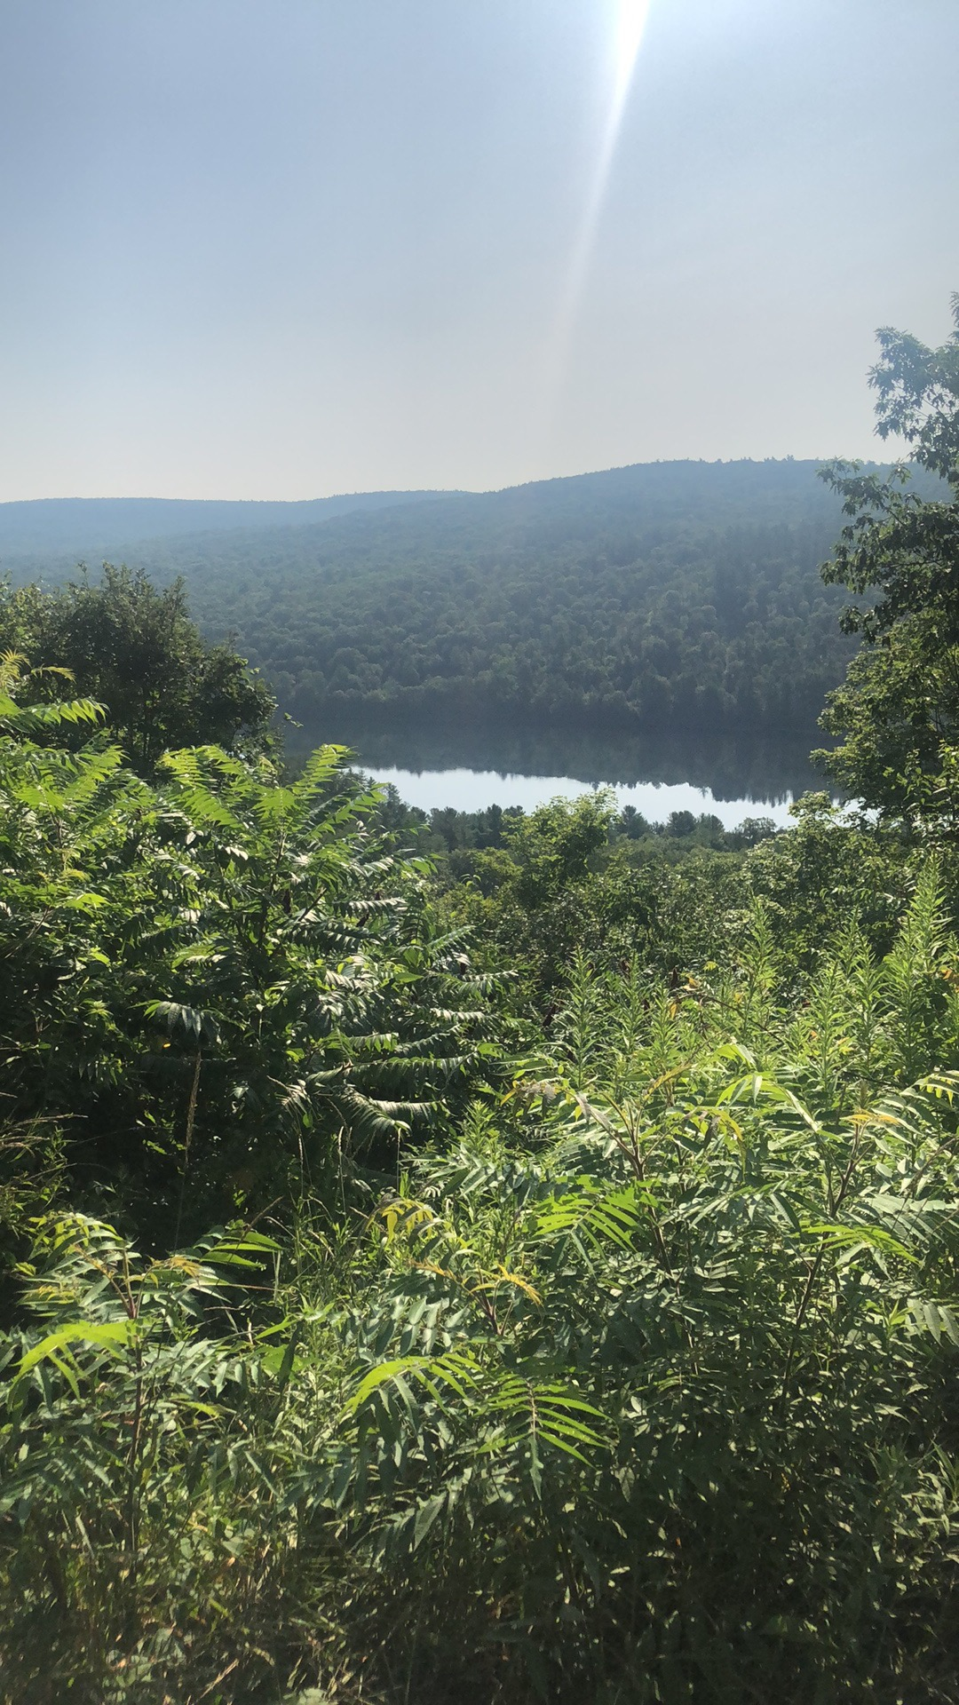
MDC Careers / Training & Education
Careers
Foresters and Forestry Technicians
Natural Resource Administrator
Watershed Inspectors
Water Supply Maintainers
Facility and Building and Grounds Maintenance
Water Treatment Plant Operators
Training/Education
High School Diploma
Environmental Science College Degree
Arborist Certification

Slide 6
The Future
Seriously considering a job in environmental sciences
Was interested in specifically wildlife rehabilitation but now interested in an overall Environmental Sciences degree

Slide 7
Customer Service
Kanijah Lawson

Slide 8
Work Responsibilities / What I learned
Responsibilities
Responding to customer emails
Checking customer balances
Updating customer information
Viewing customer accounts
Shadowing Representatives on calls
Learned
MDC has many customers; working with the customer requires good communication skills
Customer calls MDC for a variety of reasons, not just in regards to their account balances

Slide 9
MDC Careers / Training & Education
Careers
Customer Service Representative
Claims Agent
Principal Account Clerk
Financial Analyst
Billing Analyst
High School Diploma
College Degree
Business
Finance
Communications

Slide 10
The Future
Change of plans
College degree pertaining to the environment

Slide 11
Engineering
Katherine Bridges

Slide 12
Work Responsibilities / What I learned
Responsibilities
Shadowed engineers at construction sites
Viewed plans and projects specifications
Attended town leadership meetings
Tour of wastewater plant
Tour of South Hartford Conveyance Tunnel project
Overlooking damaged pipes
Overlooking Oakwood Ave. project cycle
Meeting Engineers
Learned
A lot more work than people would think goes into planning and maintaining underground infrastructure
Engineering has many different branches

Slide 13
MDC Careers / Training & Education
Careers
Engineering
Project managers
Surveyors
Safety inspectors
Project engineers
Training/Education
High School Diploma
Engineering Degree
Engineering in Training Certification (EIT)
Professional Engineer License (PE)

Slide 14
The Future
Think about all the work to put into future
What day to day life will be like after college

Slide 15
Operations
Christian Diaz and Diquan McLaren

Slide 16
Work Responsibilities / What I learned
Responsibilities
Replacing Meters
Checking the amount of chlorine in Hydrants
Rewiring the meters
Visual read of the meters
Use of metal detectors to find meters
Operating CCTV visual equipment
Learned
A lot more hands-on work than expected at the District
Owns a lot of property (2nd largest landowner in CT)
Just under one hundred staff in operations systems maintenance and repair

Slide 17
MDC Careers / Training & Education
Careers
Meter Readers
CCTV Technician
Utility Maintainers
Training/Education
CDL
Drivers license
High School Diploma

Slide 18
The Future
Future in the MDC
Would have never thought about being here before this program
Definitely could see ourselves working here

Slide 19
Reservoir 6
Luis Coraspe (Lab)
Parth Patel (Water Treatment)

Slide 20
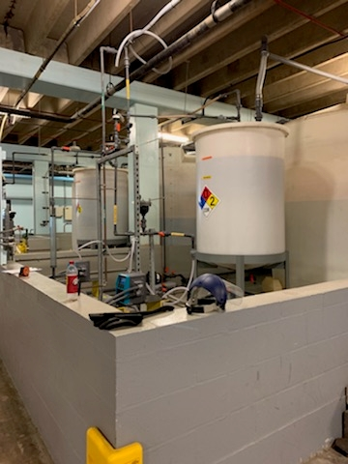
Work Responsibilities
Parth
Fill chemical tanks
Fill logs of the chemical tanks
Monitor chemicals periodically throughout the day
Clean carbon machine
Open telescopic system
Water samples from West Hartford Filters
Luis
Prep and sterilize sample bottles for bacteriological analyses
Microbiological analysis of water samples
Routine analysis of water samples (pH, Turbidity, color)
Entering data into LIMS

Slide 21
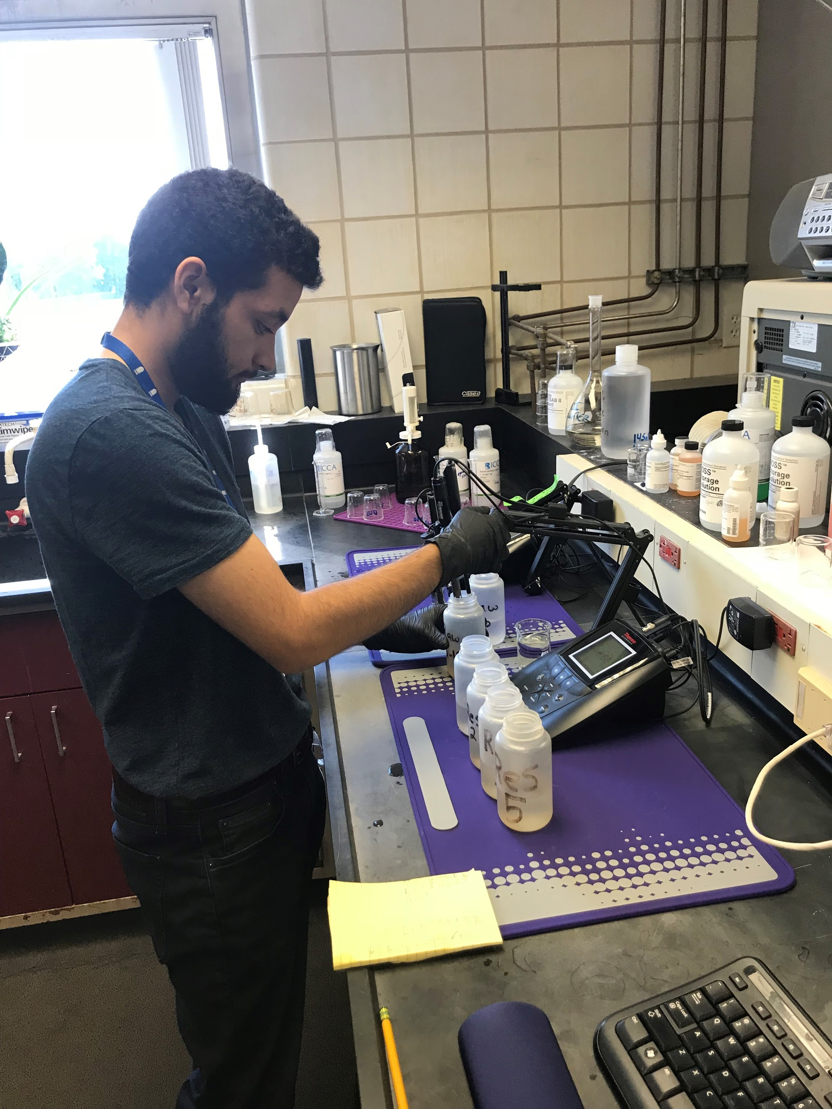
What did we learn about the MDC
Parth
Diversity of jobs here
Continuous education to move up in the chain of command
Process to make potable water requires a lot of time and energy
Luis
A lot of testing that happens all day everyday
Have to meet certain standards of reporting
If not met have to send a public notice

Slide 22
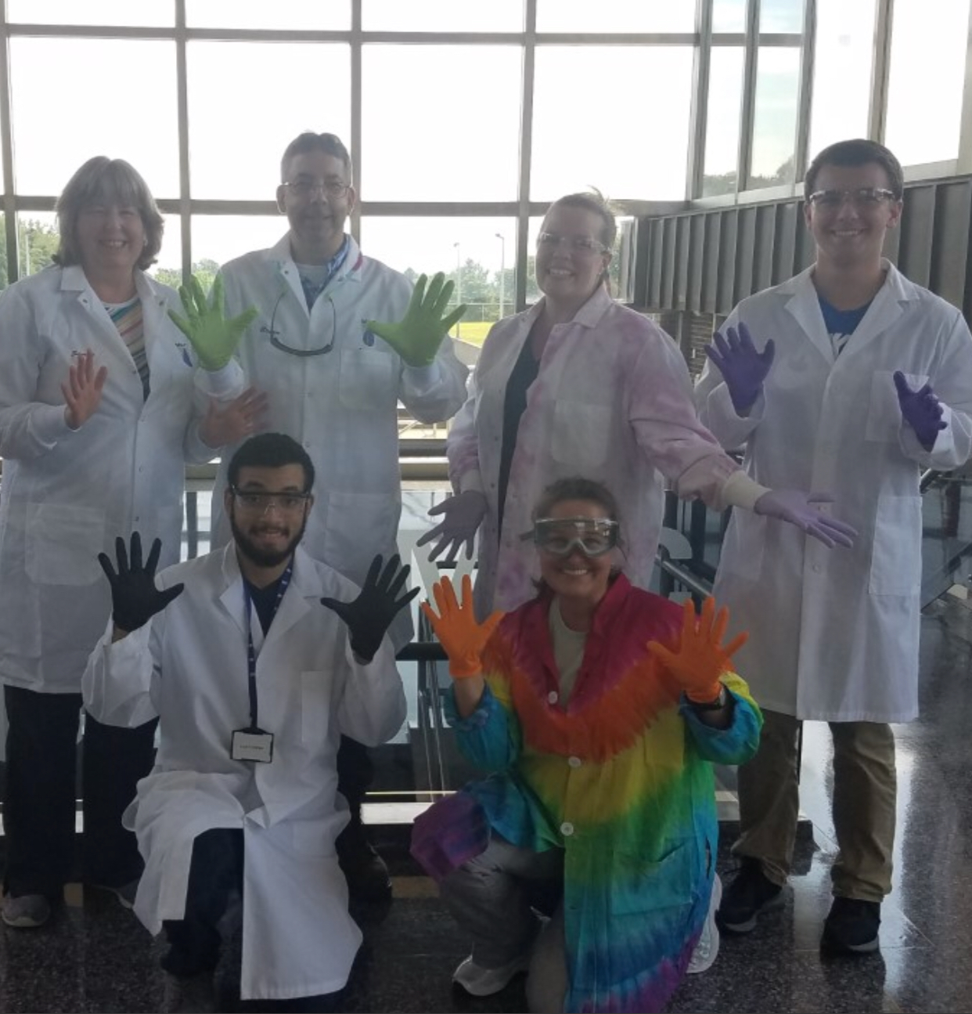
MDC Careers
Parth
Water Treatment Plant Operator
Water Treatment Maintainer
Luis
Laboratory Technician
Microbiologist
Chemist

Slide 23
Training and Education
Parth
High School Diploma
Passing water operator certification exam
Water courses in college
Luis
High School Diploma
College Degree
OSHA safety training

Slide 24
The Future
Parth and Luis
Would want to work here after high school
Great environment
People are friendly

Slide 25
Wastewater Treatment
Nicolas Capasso and Trey McCormack

Slide 26
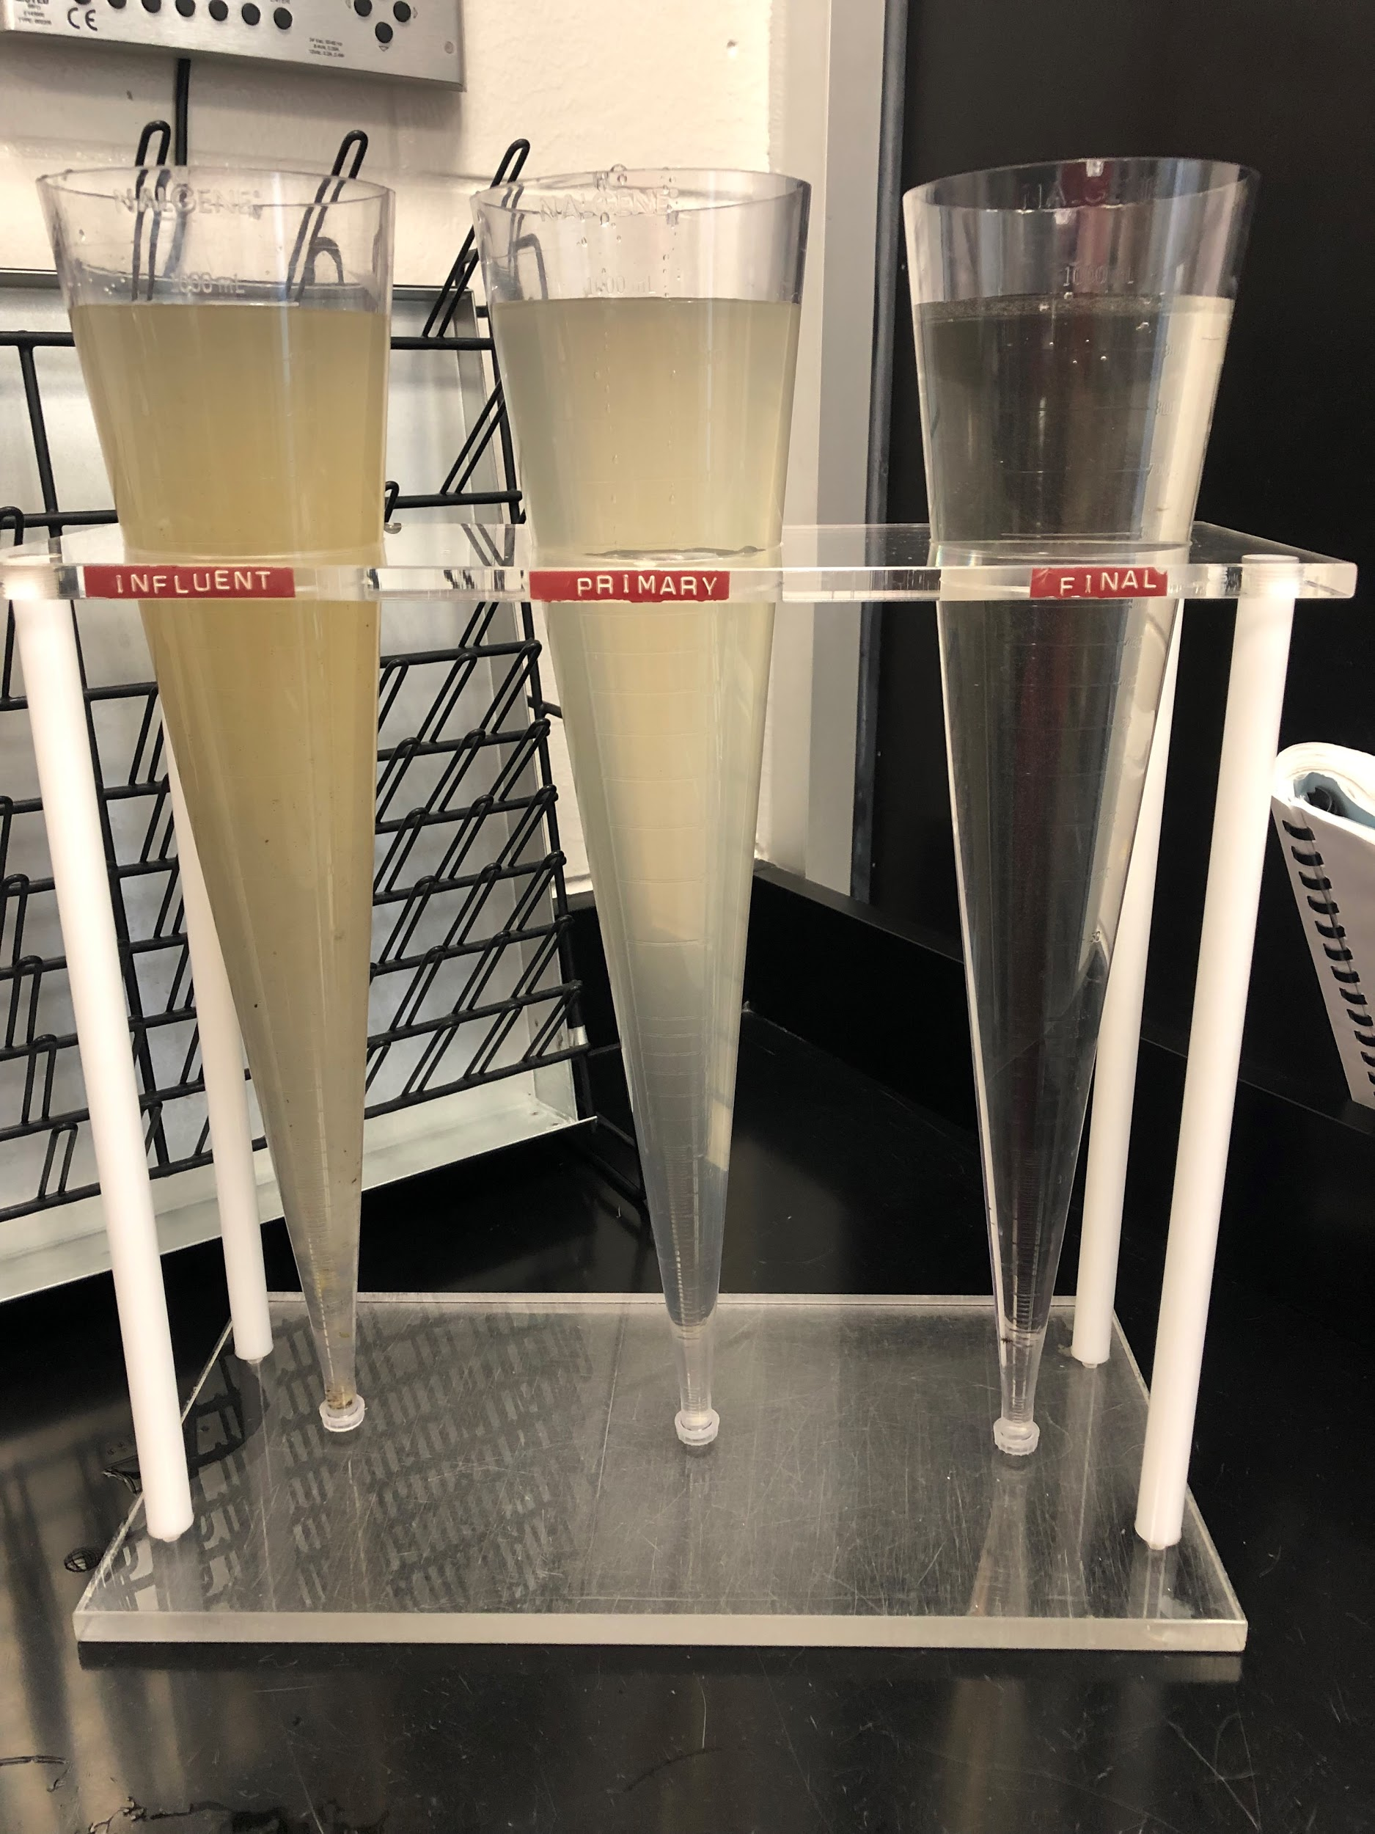
Work Responsibilities / What I learned
Responsibilities
Lab
Taking samples of water
Running tests of samples
Filter cleaning
Inspection
Checking pumps
Cleaning bar racks
Skimming floatables
Learned
A lot of money that goes into the treatment of wastewater
Many different stages of treating wastewater

Slide 27
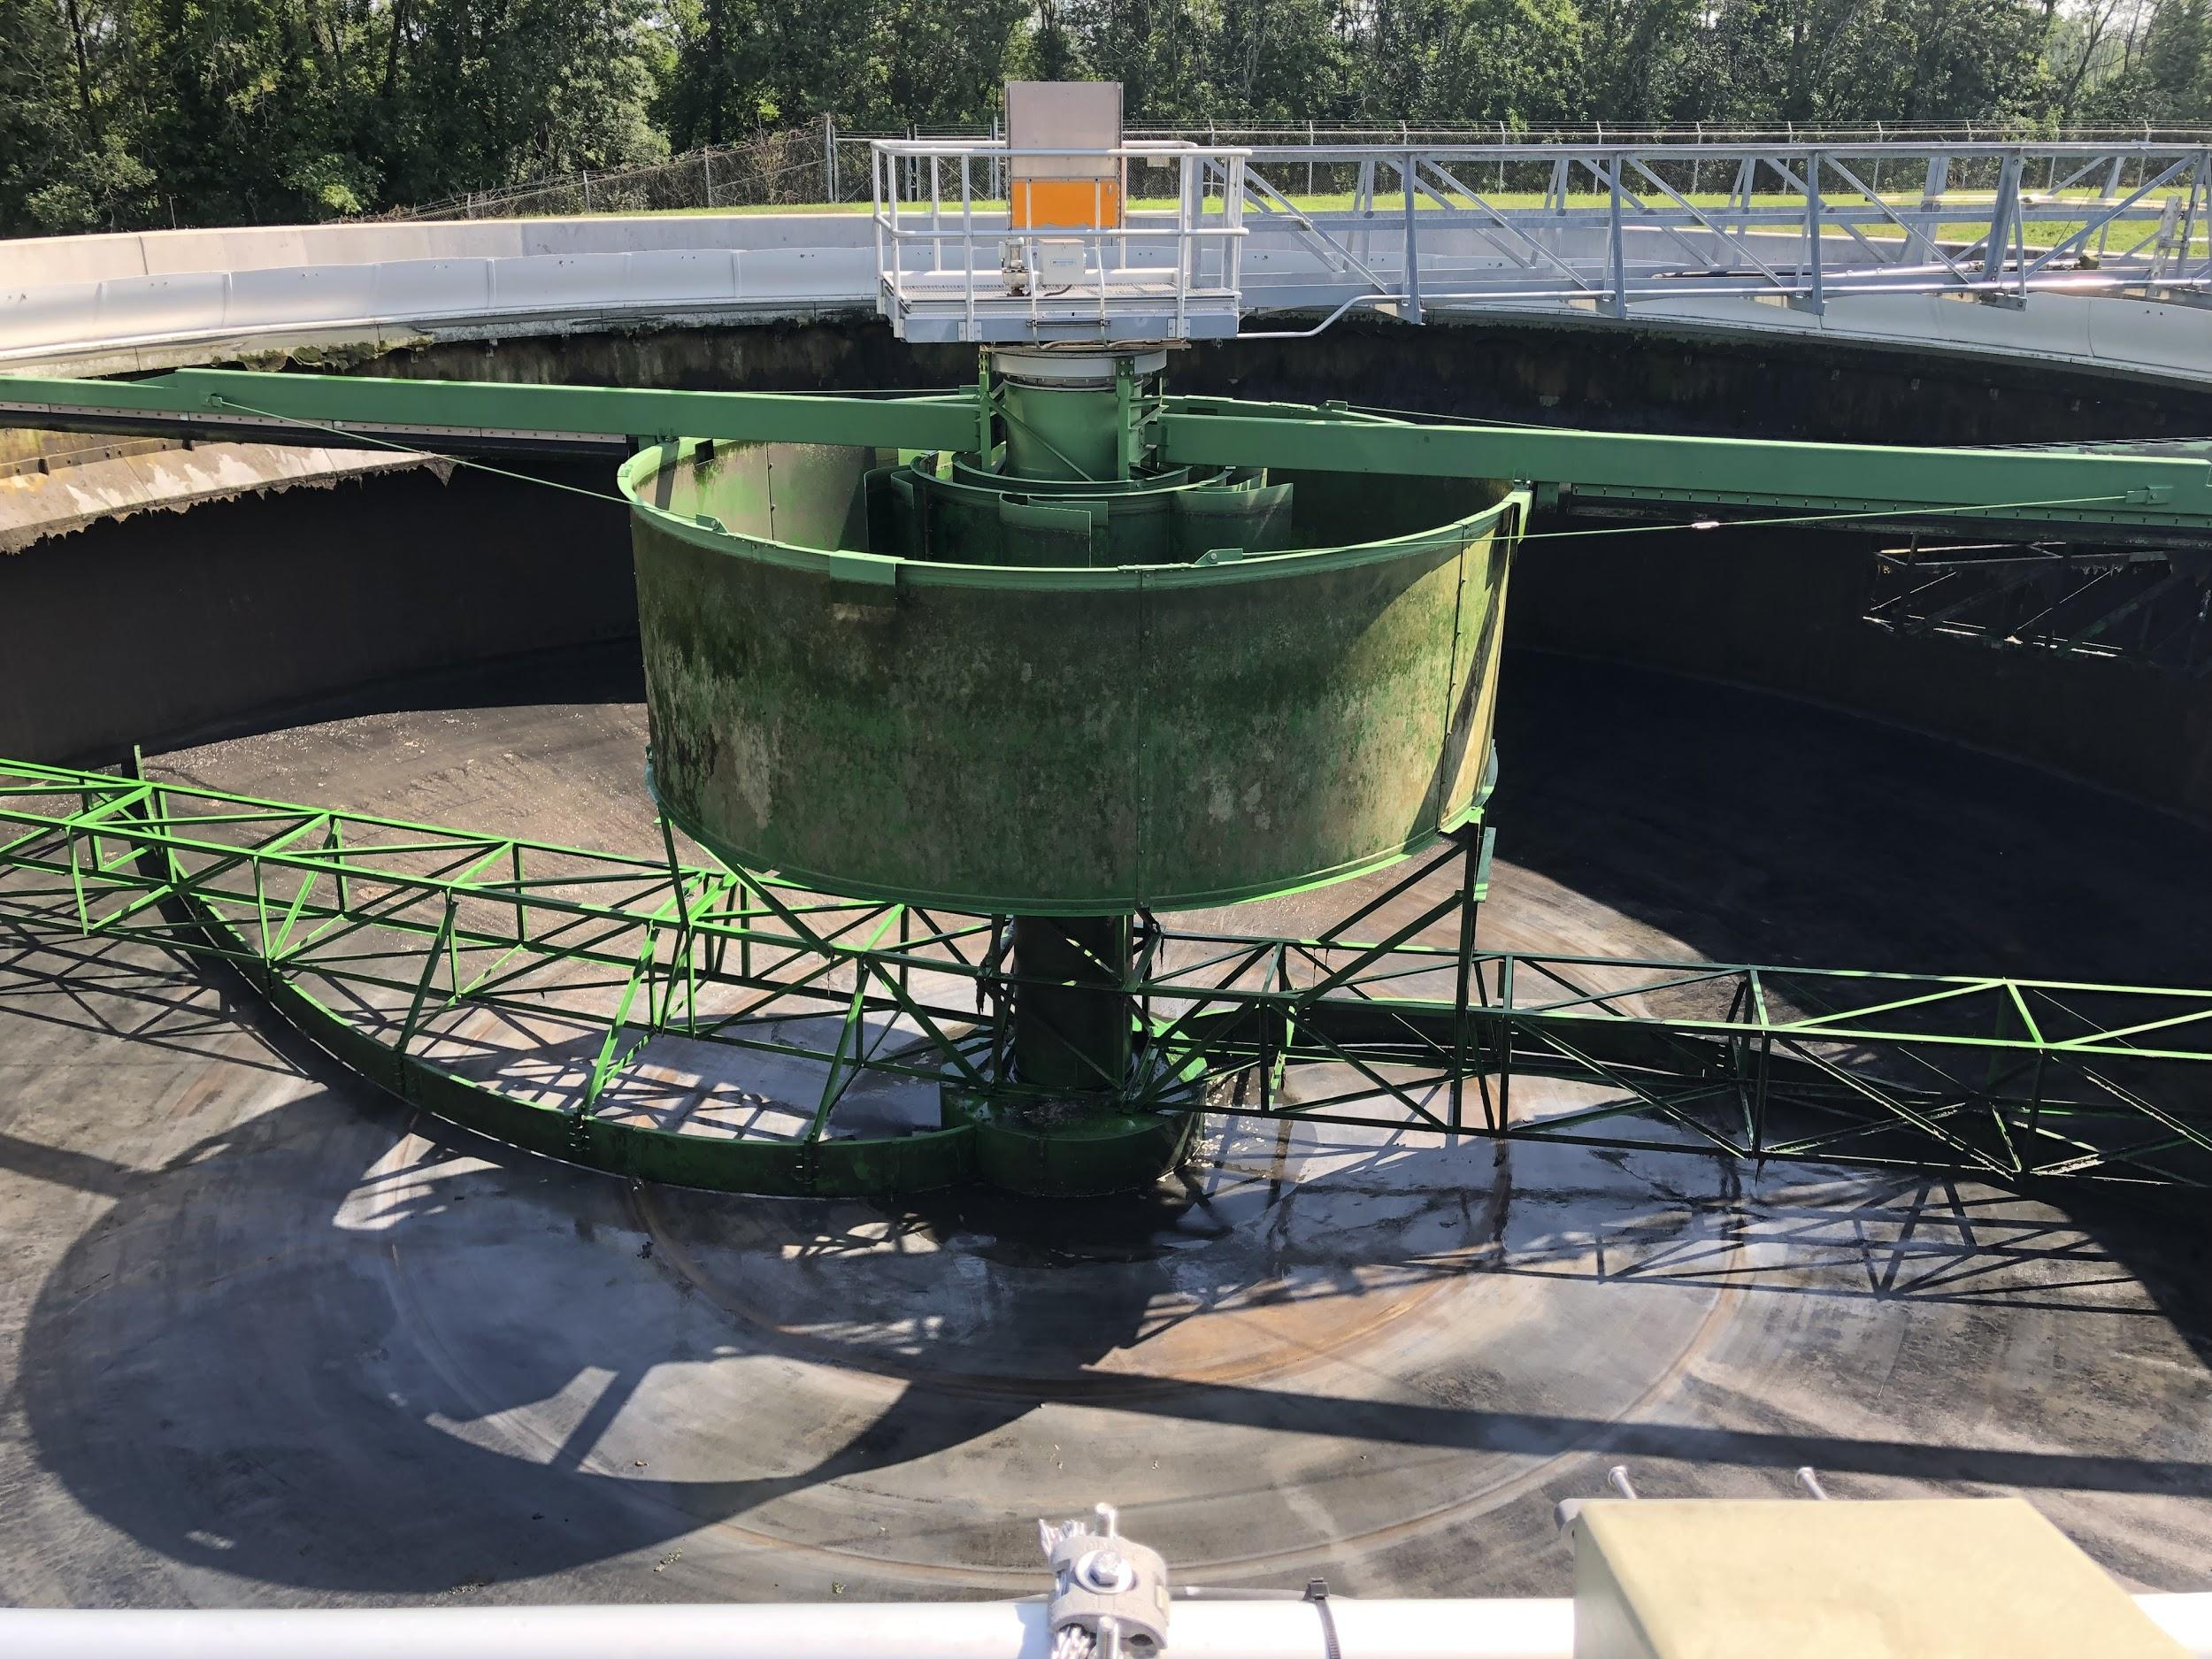
MDC Careers / Training & Education
Careers
Wastewater Plant Operators
Wastewater Plant Supervisor
Inspectors
Training/Education
High School Diploma
Class 1 License
Year of experience

Slide 28
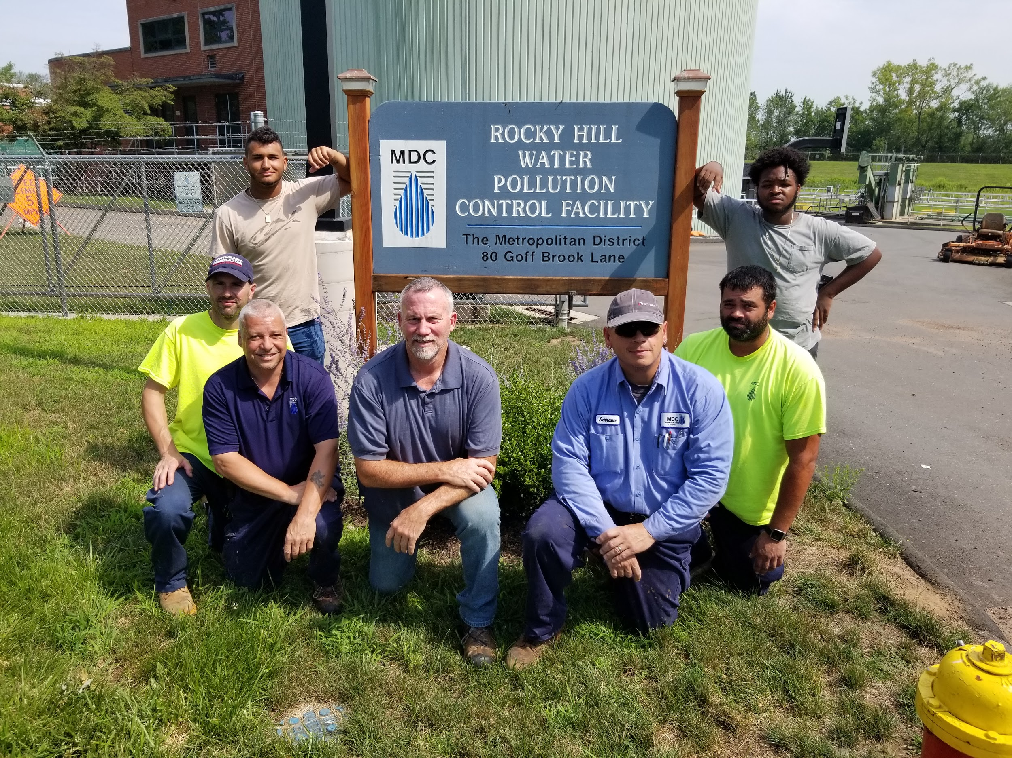

Slide 29
The Future
Gave more options after high school
Better idea and understanding of the wastewater treatment opportunities

Slide 30
West Hartford Filters
Martin Burke

Slide 31
Work Responsibilities / What I learned
Responsibilities
Detailed tour of the filter beds
Visit chemical plant
Needs to be open 24 hours/day
Daily periodic testing requirements
Viewing the operations of the slow sand filtration plant
Learned
The different chemicals added to the water
There is testing of the chemical levels in the water so it is potable and only the cleanest water reaches the MDC customers
Chlorine
Phosphate

Slide 32
MDC Careers / Training & Education
Careers
Water Treatment Plant Operator
Water Treatment Maintainer
Training/Education
High School Diploma
Passing water operator certification exam
Water courses in college

Slide 33
The Future
Wanting to come back here after schooling

